Slide 1

CORMEUM
Presented by Anastasia, Seungbin, Bekzod, Rashed
June 28, 2019
CORMEUM pvt. ltd.
Notes:
Good morning Ladies and Gentlemen!
We are group COR-MEUM which from latin translates as MY HEART, and we’ll be giving you our hearts for the next 30 minutes!

Slide 2
Agenda
About Us
Problem Statement
Market Validation and size
Value Proposition
Our Solution and Product
Conclusions and future work
Notes:
We will be talking a little bit about ourselves, the problem we decided to be challenged with, our vision of the market and value proposition.
Then we will move to the demo part to present our solution and conclude with our key learnings and future steps.

Slide 3
About us

Slide 4

Who We Are
Mission
Vision
CORMEUM Private Limited is a newly formed company established by four young entrepreneurs who are willing to create products for medical industry to make people's life better and safer.
To provide superior quality healthcare service feature that: HEART PATIENTS use for their peace of mind, PHYSICIANS prefer for their patients, EMPLOYEES are proud of, and INVESTORS get long term return from.
A world where people will have more chance to survive despite suffering from
a sudden heart attack or stroke.

Slide 5


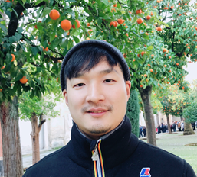

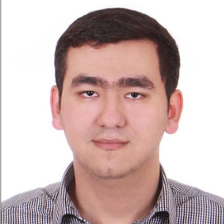

Founding Members
Anastasia Gracheva
Seungbin Yoo
Bekzod Sharipov
Rashedul Hasan

Slide 6
Problem Statement
Notes:
So what is the topic we chose, what is our interest?
During the last years we’ve seen numerous applications of AI , some of them brilliant and some are quite questionable.
If we speak about medicine , it might seem the obvious first priority industry where the paragon solutions should be. However, it’s not quite so.
There has been a lot of scepticism coming mainly from doctors, and a lot of questions whether AI could “beat” them.
The thing is, it doesn’t exactly has to beat them , but what it has to do is help them with the decisions, and help patients at a stage where they would possibly avoid a visit to a doctor, or , on the opposite, the case where they would need one but don’t suspect about it at the moment.
The narrative is so distorted towards extreme visions that artificial intelligence is either presented as the ultimate evil destroying mankind or the only source of the future prosperity of humanity.
Now let’s go to the problem statement.

Slide 7
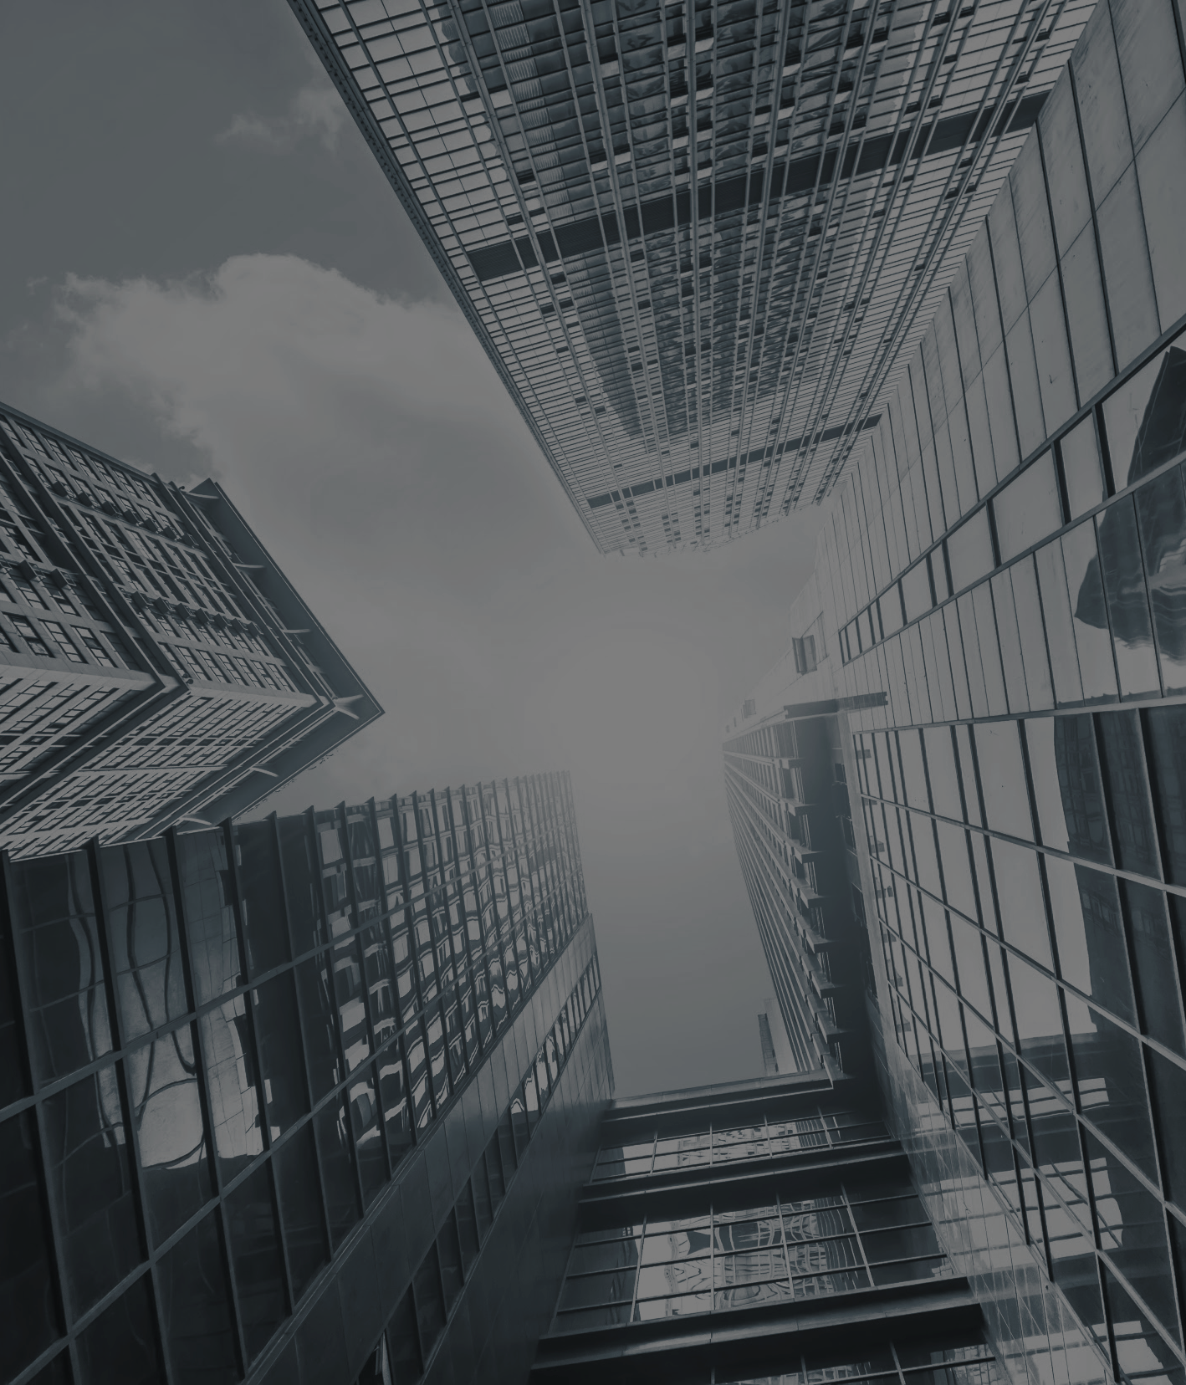
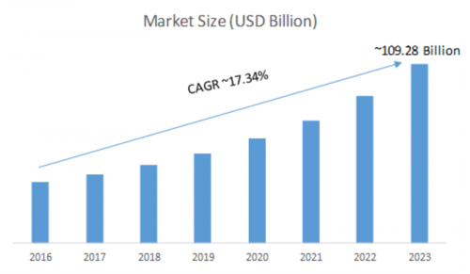
Numbers
56%
Growth Q4’17 to Q4 ‘18
54%
YoY
2017 - 2018
Notes:
https://www.reuters.com/brandfeatures/venture-capital/article?id=97252

Slide 8

45% of the people who have suffered heart attacks is called “silent variety”
Notes:
Of the 56.9 million deaths worldwide in 2016, more than half (54%) were due to the top 10 causes. Ischaemic heart disease and stroke are the world’s biggest killers, accounting for a combined 15.2 million deaths in 2016. These diseases have remained the leading causes of death globally in the last 15 years.

Slide 9
Facts of Problem Statement
A research published in American Heart Association journal (Circulation) found that people who have silent heart attacks are three times more likely to die of heart disease.
Patients believed they had strained a muscle or had indigestion and some even thought it was minor flu
Every year 790,000 a Americans have heart attack and one of 5 attacks is silent.
Source: Independent (May 17, 2016)
Notes:
and that’s only in the States!

Slide 10
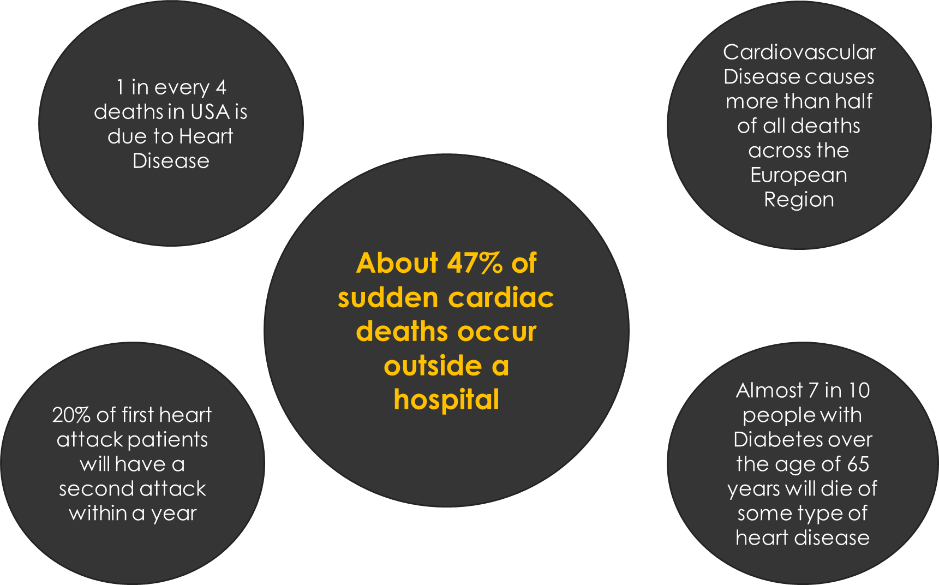
”
Notes:
With that in mind, we thought of an opportunity ...

Slide 11
Market Validation & Size
Notes:
As the shipments of smart wearable devices grow extensively, people can better observe their vital signals without special medical equipment...

Slide 12
Market Validation & Size
In 2018 (Q4) global Smartwatch shipments grew by 56.9% YoY to reach 18.2 million units and in 2018 the shipment was all time high of 45 milion units
As per CCS insight (a research analytics company) worldwide smart wearables market is set to become $27 billion industry with 233 million units of sales by 2022.
*https://www.marketresearchfuture.com/reports/heart-rate-monitor-market-1370
Notes:
According to the report published by Market Research Future, titled ‘Global Smartwatches Market’ states that the market has been rushed high with a valuation of USD 109.28 billion by 2023 and is projected to reach this valuation at a CAGR of 17.34%. This current growth rate is estimated to come up with golden opportunities in the next five years.

Slide 13
FDA Approvals for AI Based Algorithms in Cardiology
PhysiQ Heart Rhythm Module - detection of atrial fibrillation
Verily - ECG feature of the Study Watch
Verily - ECG feature of the Study Watch
AliveCor -
detection of atrial fibrillation
Biofourmis - cardiac arrhythmias detection
2014
2018
2019
05.2019
2017
2018
2019
Lepu Medical - detecting arrhythmias
BioFlux - detecting arrhythmias
APPLE - detection of atrial fibrillation
AliveCor -
six-lead smartphone ECG
Notes:
Biofourmis - 2019 (RhythmAnalytics cloud-based software that uses artificial intelligence techniques to automate the interpretation
of cardiac arrhythmias from ECG tracings)
Radiology and cardiology seem to be heavily populated by artificial intelligence-based solutions, there are already seven approved algorithms in cardiology, while 16 in radiology.

Slide 14
Our Solution and Product

Slide 15

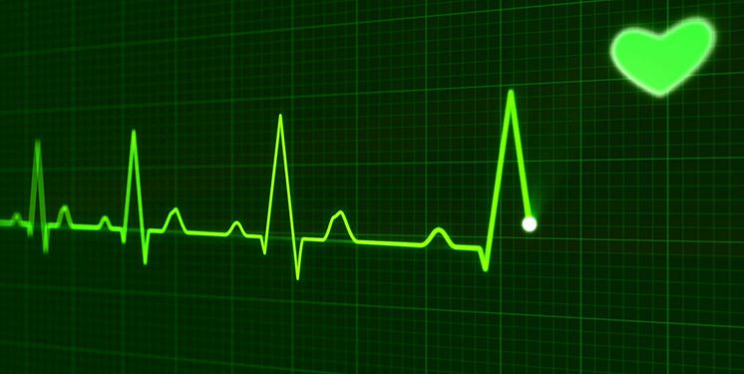
1. An algorithm that detects anomalies of heart beat from ECG / EKG 2. Alerts the emergency services immediately (development phase)
ALGORITHM
https://github.com/bb426/cormeum

Slide 16
Value Proposition

Slide 17
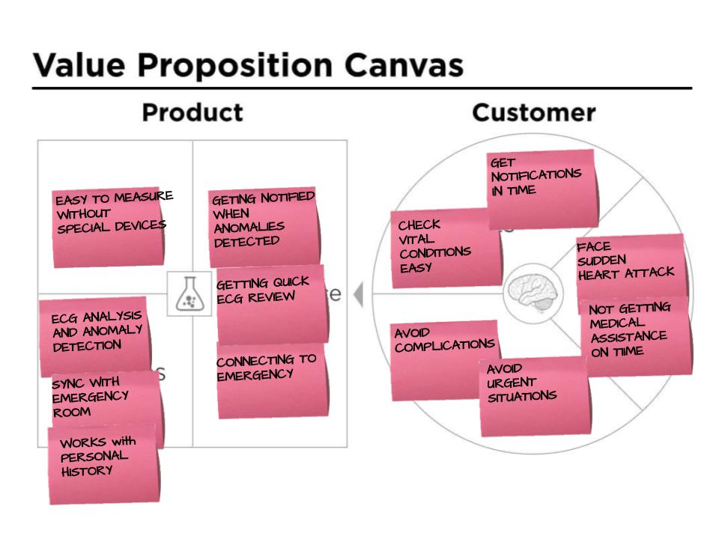
Customer Value Proposition

Slide 18
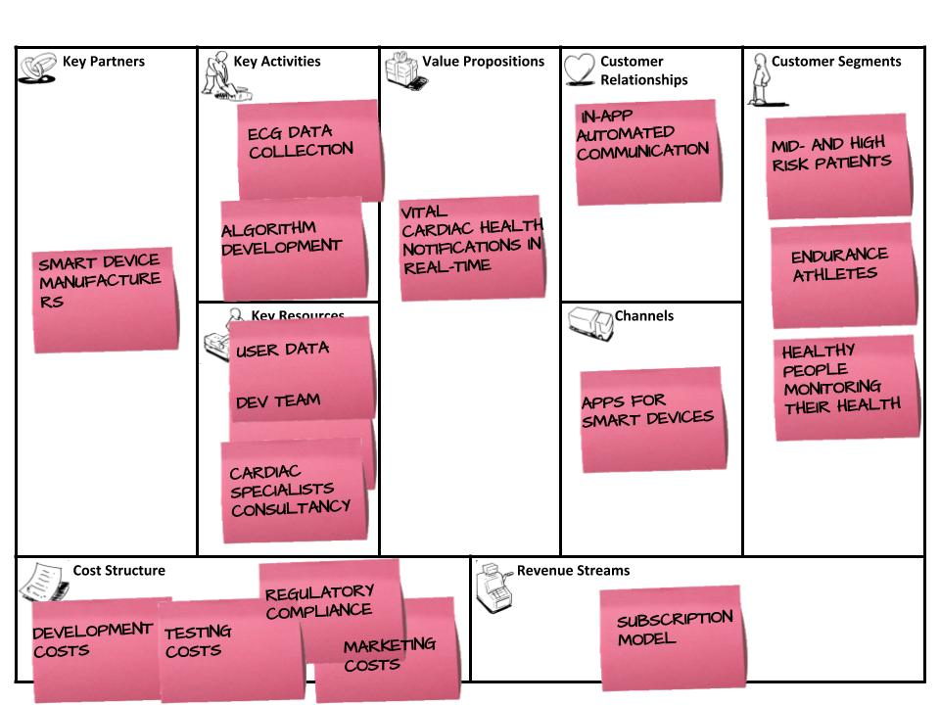
Business Model Canvas

Slide 19
Financials

Slide 20
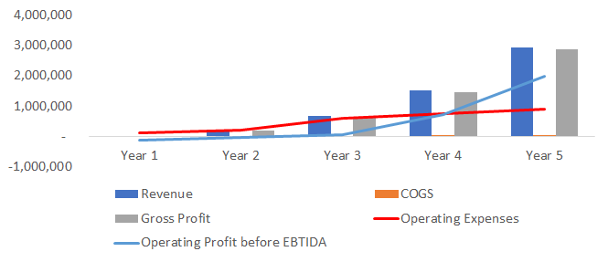
Financials

Slide 21
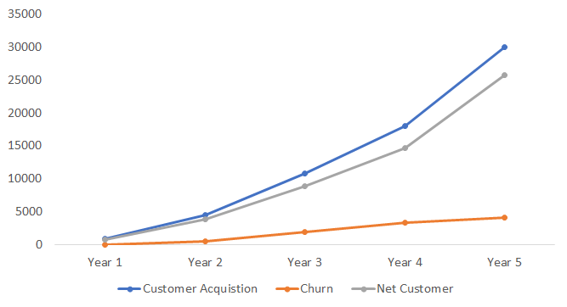
Customer acquisition

Slide 22
Technical part

Slide 23

1. How to get ECG data
2. What is an ECG
3. Feature extraction
4. Preprocessing
4.a. Normalization
4.b. Encoding & Undersampling
5. Building a ML model
5.a. Benchmark
5.b. Optimization
5.c. Summary
Data Source
Open source datasets containing ECG signals (https://physionet.org/)
Data Description
8,528 single lead ECG records
Lasting from 9s to 60s
300Hz : Producing ECG at 300 times per second
4 classes (Normal, Atrial fibrillation, Other, Noise)
Notes:
From now on, we are going to explain how we build our model.
The most valuable resource to build a machine learning model is dataset. However, Collecting medical dataset requires a lot of time and money, and it always has a risk related to privacy issues.
To avoid this complicated problem, many researchers rely on opensource data. We also get our dataset on the public which has 8,000 observations with 4 classes.

Slide 24
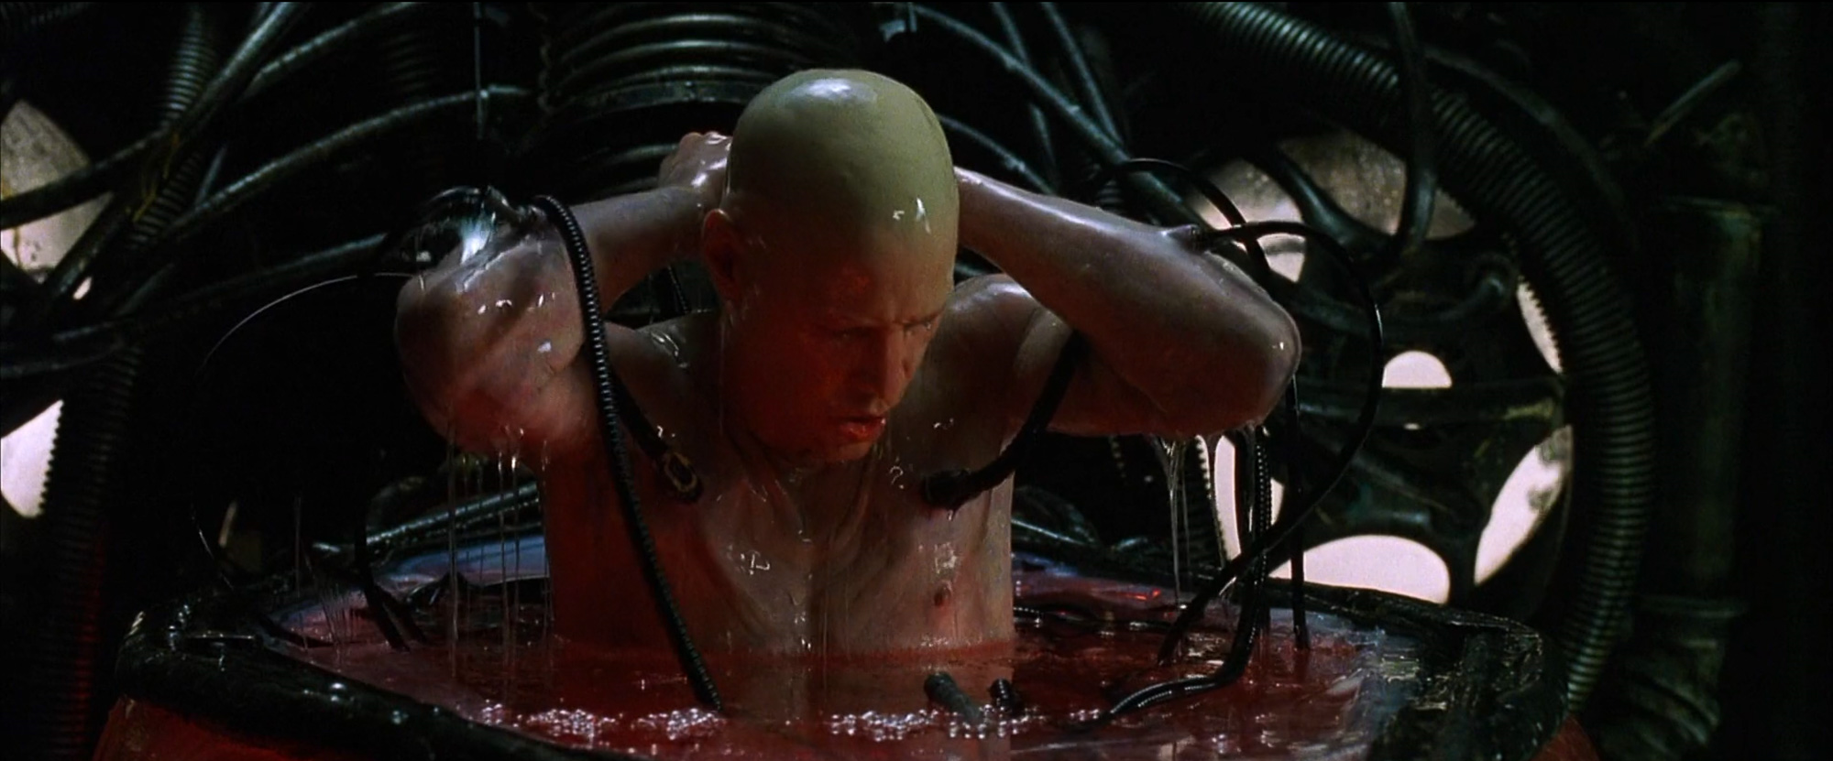
1. How to get ECG data
2. What is an ECG
3. Feature extraction
4. Preprocessing
4.a. Normalization
4.b. Encoding & Undersampling
5. Building a ML model
5.a. Benchmark
5.b. Optimization
5.c. Summary
What is an ECG?
Electrocardiogram(ECG) is a recording of the electrical activity of the heart using electrodes placed on the skin
Notes:
It give us a lot of informations about heart activity

Slide 25
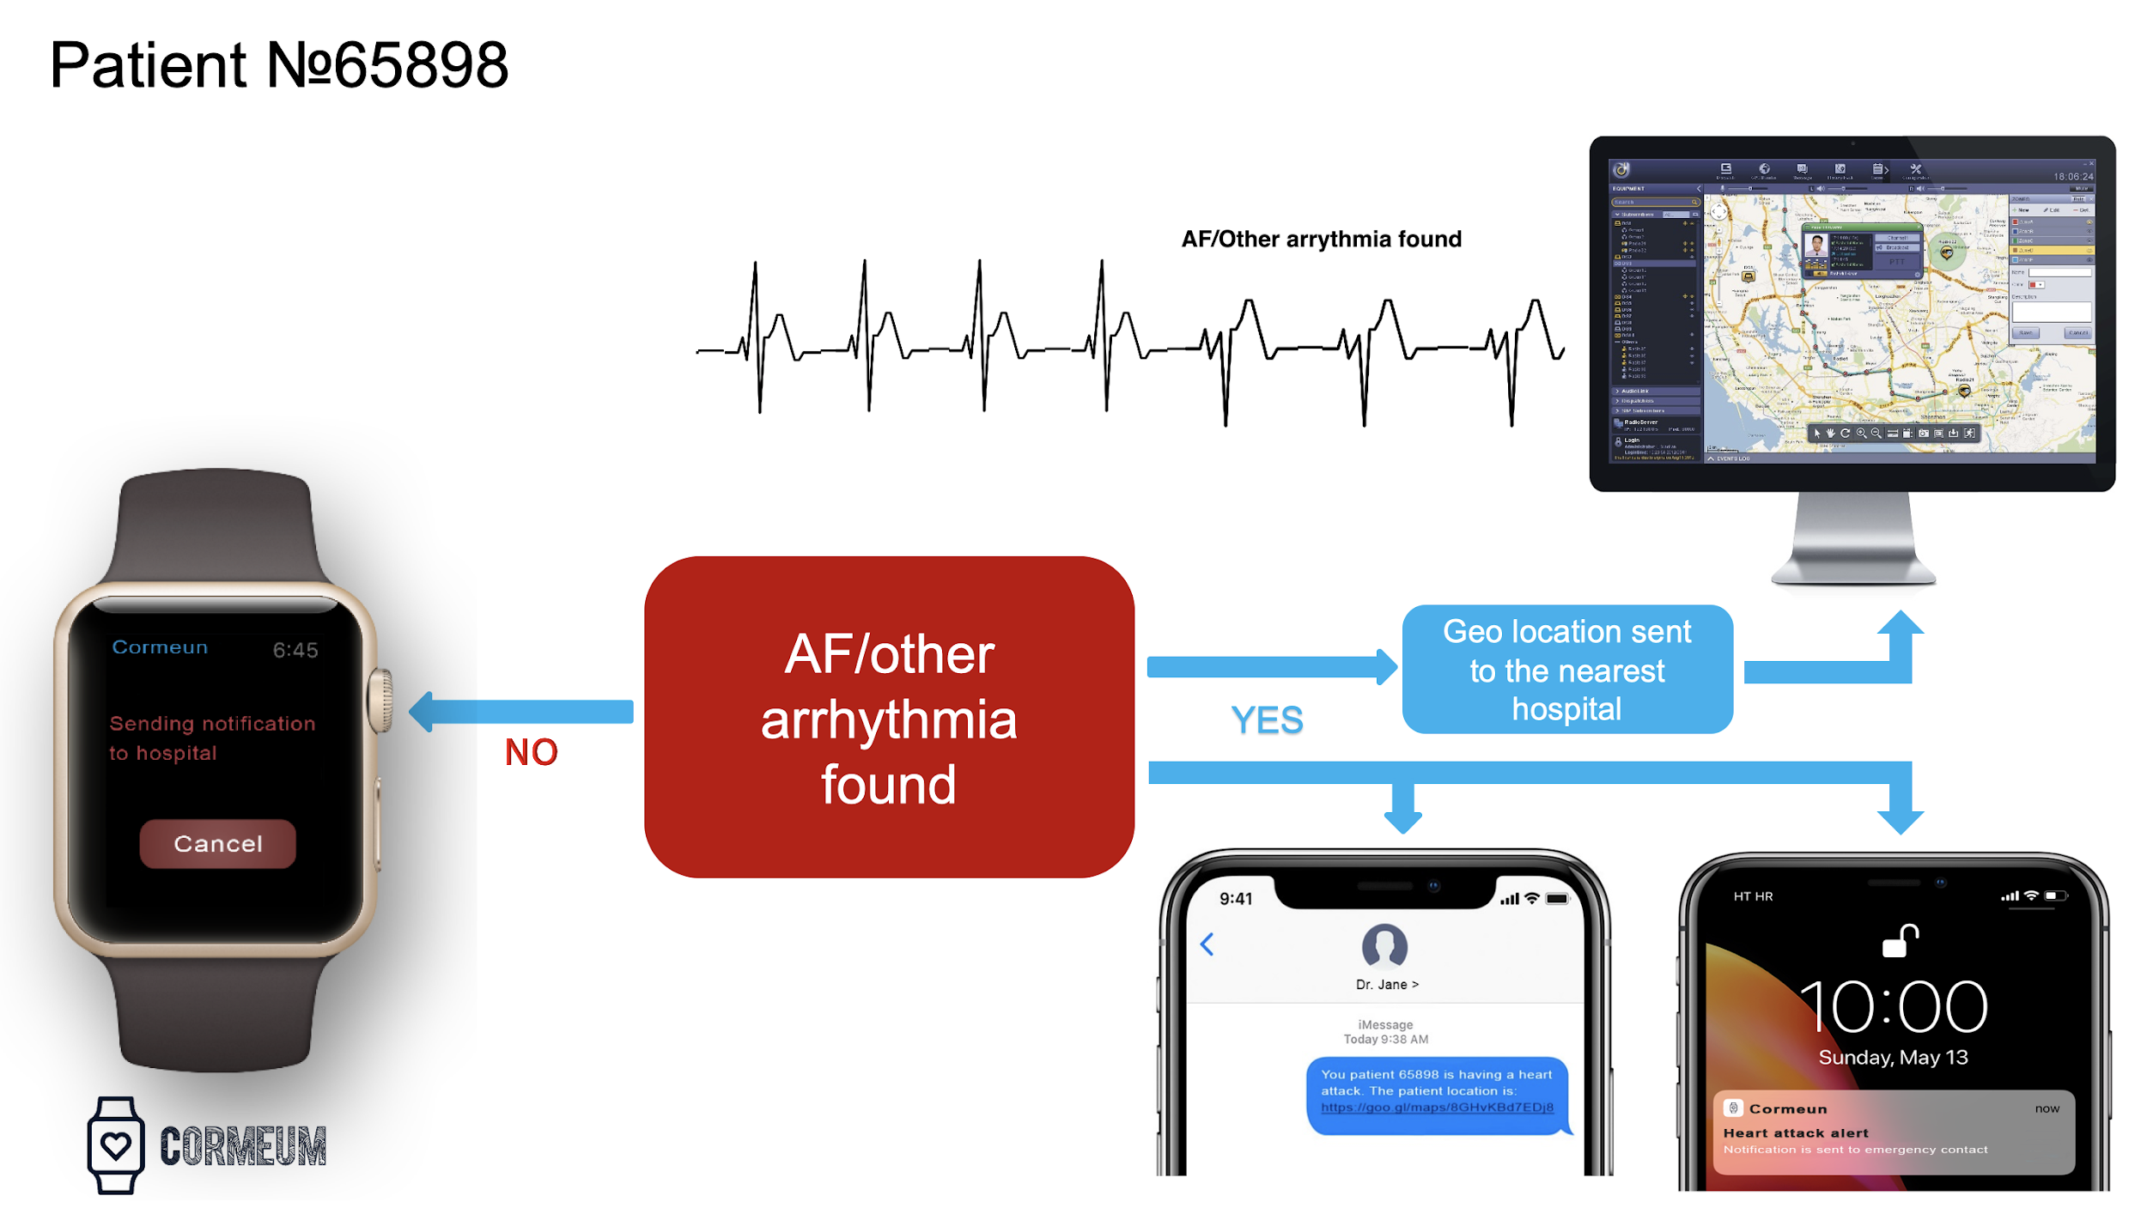
Notes:
So, Let us show blueprint of our product.
First, We receive ECG from our customer’s smart device.
Next, we process it and diagnose their condition.
If our algorithm detects abnormality, we send his location to the nearest hospital and family member.
However, in the situation we make wrong classification, in other word, type2 error, false positive,
our custumer can give a feedback to us by touching his device.

Slide 26
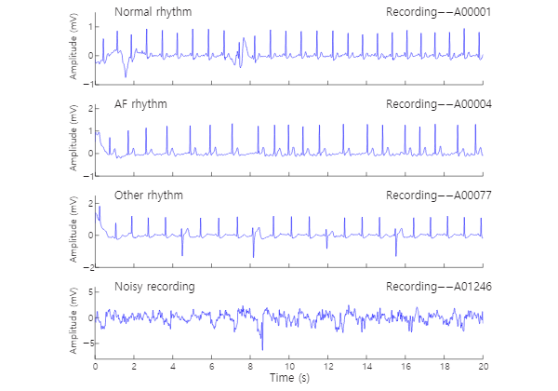
Examples of ECG waveforms
1. How to get ECG data
2. What is an ECG
3. Feature extraction
4. Preprocessing
4.a. Normalization
4.b. Encoding & Undersampling
5. Building a ML model
5.a. Benchmark
5.b. Optimization
5.c. Summary
Notes:
Those plots are a sample of each class.
We can easily classify Noise recording from other classes. But, Distinguishing the other 3 classes is not an easy task without expert knowledge in the medical field.
So, we tried to build ecg classifier to help figuring out patient's condition easily.

Slide 27

Feature engineering
Like feeding a baby bird, It is important to feed digestible data to the model.
1. What is an ECG
2. How to get ECG data
3. Feature extraction
4. Preprocessing
4.a. Normalization
4.b. Encoding & Undersampling
5. Building a ML model
5.a. Benchmark
5.b. Optimization
5.c. Summary
Notes:
Before jumping into algorithms, it is important to conduct feature engineering that making our datasets more interpretable.

Slide 28
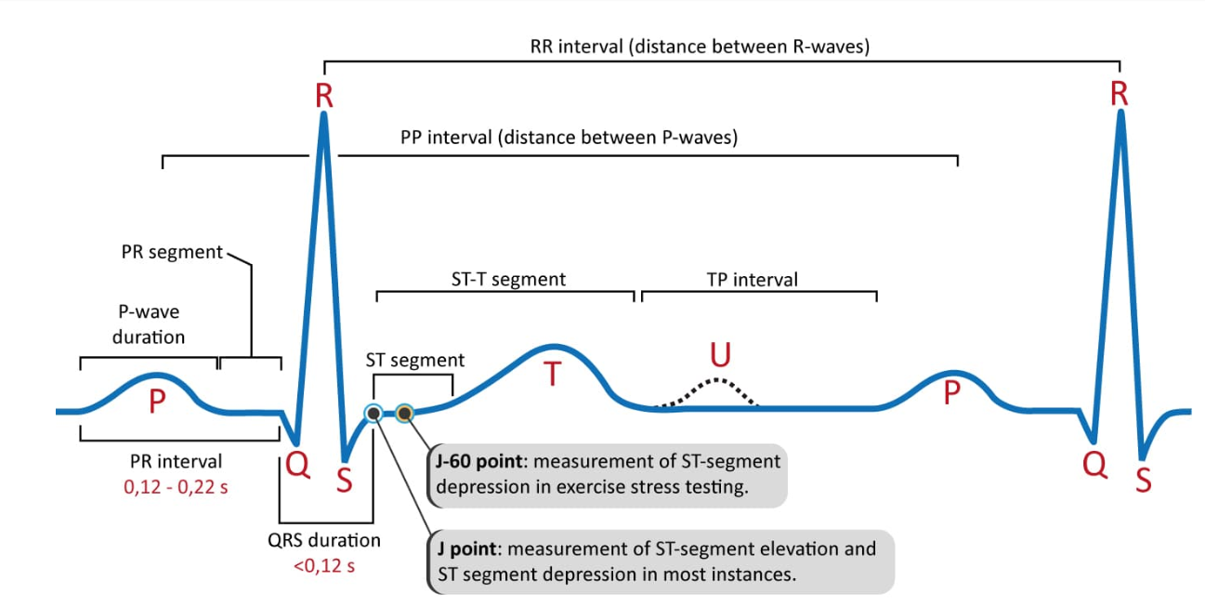
1. What is an ECG
2. How to get ECG data
3. Feature extraction
4. Preprocessing
4.a. Normalization
4.b. Encoding & Undersampling
5. Building a ML model
5.a. Benchmark
5.b. Optimization
5.c. Summary
Essential features to interpret ECG.
RR interval, QRS complex, ST segment, etc..
Notes:
The first technique we've used is feature extraction.
There are some essential features to interpret ECG patterns.
For example, RR interval, It means the distance of two consecutive R points and it shows unstable values in abnormal status.
So, Doctors, Cardiologist diagnose patient’s condition based on those information

Slide 29
1. What is an ECG
2. How to get ECG data
3. Feature extraction
4. Preprocessing
4.a. Normalization
4.b. Encoding & Undersampling
5. Building a ML model
5.a. Benchmark
5.b. Optimization
5.c. Summary
Compute features from ECG records
→ Time | timestamp_1 | timestamp_2 | timestamp_3 | timestamp_4 | timestamp_5 | timestamp_6
ECG_1 | -127 | -162 | -197 | ... | -22 | -21
ECG_2 | 57 | 73 | 85 | ... | -64 | -36
dim : 8,528 * 9,000
Feature extraction
→ Feature | PR_interval | QRS complex | QR interval | ... | QT segment | U wave
ECG_1 | 3.9 | 2.3 | 4.2 | ... | -1.5 | 1.5
ECG_2 | 5.4 | 3.5 | -1.9 | ... | 1.1 | -1.1
dim : 8,528 * 200
Notes:
Using formulas to convert ECG signals to features, we obtain 200 features from the datasets.
Before feature extractions, each column corresponds to a specific timestamp. However, now there are converted to individual features.

Slide 30
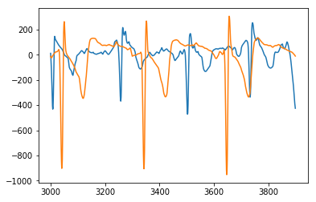
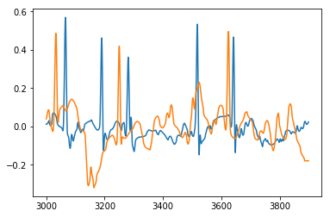
1. What is an ECG
2. How to get ECG data
3. Feature extraction
4. Preprocessing
4.a. Normalization
4.b. Encoding & Undersampling
5. Building a ML model
5.a. Benchmark
5.b. Optimization
5.c. Summary
Preprocessing : Normalization
Normalization helps a model find an optimal point easily
Range of ECG before normalizing - Blue sample : -412 ~ 205 [600]
- Orange sample : -932 ~ 217 [1200]
Range of ECG after normalizing - Blue sample : -0.1~ 0.6 [0.7]
- Orange sample : -0.3~ 0.5 [0.8]
Notes:
Another important procedure is preprocessing.
As each person has a different range of ECG values though they are in the same condition, we conduct mean-normalization to help our algorithm find an optimal point easily.

Slide 31
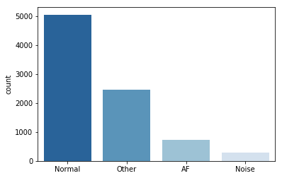
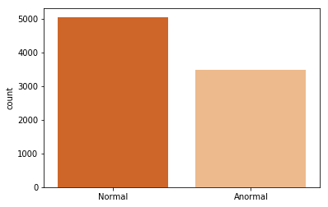
1. What is an ECG
2. How to get ECG data
3. Feature extraction
4. Preprocessing
4.a. Normalization
4.b. Encoding & Undersampling
5. Building a ML model
5.a. Benchmark
5.b. Optimization
5.c. Summary
To focus on classifying the abnormal status, three irregular classes are grouped into one class.
Undersampling techniques were applied as well to increase validation performance
Notes:
Also, We gather three irregular ECG signal as one abnormal status to focus on classifying normal and abnormal. After that, to handle the imbalanced dataset, undersampling technique is applied as well.

Slide 32
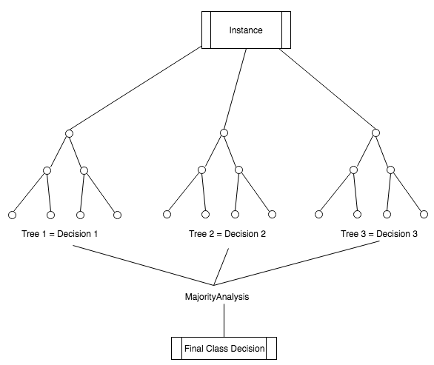
Algorithms for classification
1. What is an ECG
2. How to get ECG data
3. Feature extraction
4. Preprocessing
4.a. Normalization
4.b. Encoding & Undersampling
5. Building a ML model
5.a. Benchmark
5.b. Optimization
5.c. Summary
Logistic Regression
SVM with Kernels
Ensemble Models
Neural Networks
Notes:
Random-forests is a widely used ensemble model that integrates many different decision trees
biased in different ways to improve overall performance for a task.
The main advantage of this algorithm is its robustness performing fairly well without any configuration.

Slide 33
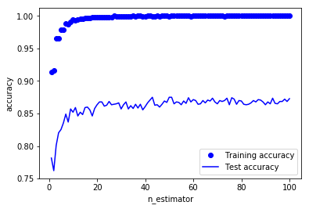
1. What is an ECG
2. How to get ECG data
3. Feature extraction
4. Preprocessing
4.a. Normalization
4.b. Encoding & Undersampling
5. Building a ML model
5.a. Benchmark
5.b. Optimization
5.c. Summary
Performance of our first RandomForest model
85% accuracy on validation set
Notes:
Instead of trying building a perfect model in the first trial, build a simple model, and use it as a benchmark is efficient ways to solve the problem.
The first model we built without any configuration achieves 85% accuracy on a validation set which is not too bad as a first try.
However, While Training accuracy is converged to 1, validation accuracy has not overcome its bottleneck. A primary solution is getting more data to train, but it is not an option we have.

Slide 34
1. What is an ECG
2. How to get ECG data
3. Feature extraction
4. Preprocessing
4.a. Normalization
4.b. Encoding & Undersampling
5. Building a ML model
5.a. Benchmark
5.b. Optimization
5.c. Summary
Hyperparameter : pre-pruning
Cond: PR_interval < 3.9
class = Normal
True
False
Cond: QRS complex < 2
class = Normal
Cond: QR interval < 5.2
class = Abnormal
True
False
Cond: QT segment < 2.5
class = Normal
Cond: W wave < -1.1
class = Abnormal
True
False
Cond: QS_diff < 1.3
class = Normal
Cond: T_kurt< -0.1
class = Abnormal
True
False
True
False
Cond: P_kurt < 0.2
class = Normal
Cond: P_skew < 2.7
class = Abnormal
Cond: P_std < 0.4
class = Normal
Cond: hr_max < -1.3
class = Abnormal
. . .
limit : max_depth=50
Notes:
More achievable option is configuration like pre-pruning.
By adding a limitation on the level of max depth, we can induce the model to be generalized on data that has not introduced during training procedure.

Slide 35
1. What is an ECG
2. How to get ECG data
3. Feature extraction
4. Preprocessing
4.a. Normalization
4.b. Encoding & Undersampling
5. Building a ML model
5.a. Benchmark
5.b. Optimization
5.c. Summary
Hyperparameter : randomness
Each tree can make a decision using a different subset of the features
→ | ... | Selected features |  |  | ...
ECG_1 | ... | ... | ... | ... | ...
ECG_2 | ... | ... | ... | ... | ...
ECG_3 | ... | ... | ... | ... | ...
ECG_4 | ... | ... | ... | ... | ...
→ | Feature1 | Feature2 | ... | F198 | F199
ECG_1 | 3.9 | 2.3 | ... | -1.5 | 1.5
ECG_2 | 5.4 | 3.5 | ... | 1.1 | -1.1
ECG_3 | ... | ... | ... | ... | ...
ECG_4 | ... | ... | ... | ... | ...
→ | ... | ... | ... | ... | ...
ECG_1 | ... | ... | ... | ... | ...
ECG_2 | ... | ... | ... | ... | ...
ECG_3 | ... | ... | ... | ... | ...
ECG_4 | ... | ... | ... | ... | ...
max_features=30
Notes:
Max features is another important parameter. It makes the algorithm randomly chooses a set of features and uses it to build a model. Though it means each tree uses a part of the data we have, It is useful to fix overfitting in practice.

Slide 36
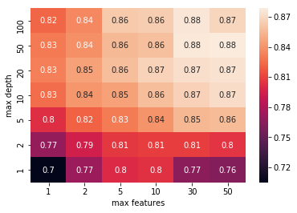
1. What is an ECG
2. How to get ECG data
3. Feature extraction
4. Preprocessing
4.a. Normalization
4.b. Encoding & Undersampling
5. Building a ML model
5.a. Benchmark
5.b. Optimization
5.c. Summary
Performance of the model after configuration
3%p improvement
https://github.com/bb426/cormeum
Notes:
After configuration, we achieve 3%p improvements on a validation set.
In fact, We also tried to build a classifier using more complex architecture,1Dimension-convolutional neural networks.
However, its performance was far below than the benchmark we made. Because the model was too complicated to make classification with only 8,000 samples.
On the other word, the result we got with random forest reached near upper-bound performance with the dataset.

Slide 37
Architecture

Slide 38
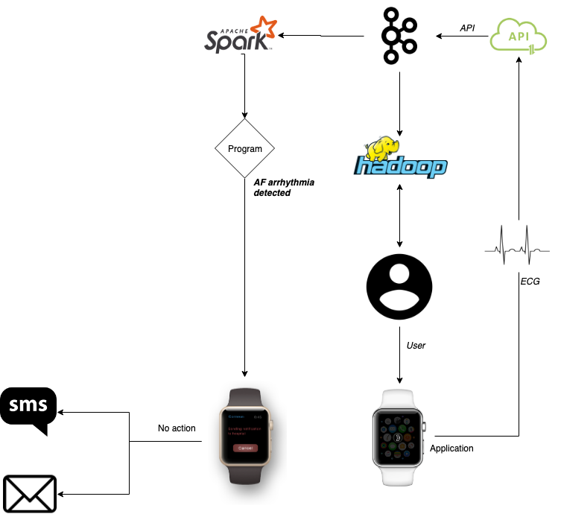
Notes:
SAY EXACTLY WHAT EACH PHASE DOES , HOW ARE WE GONNA USE KAFKA, SPARK, ETC

Slide 39
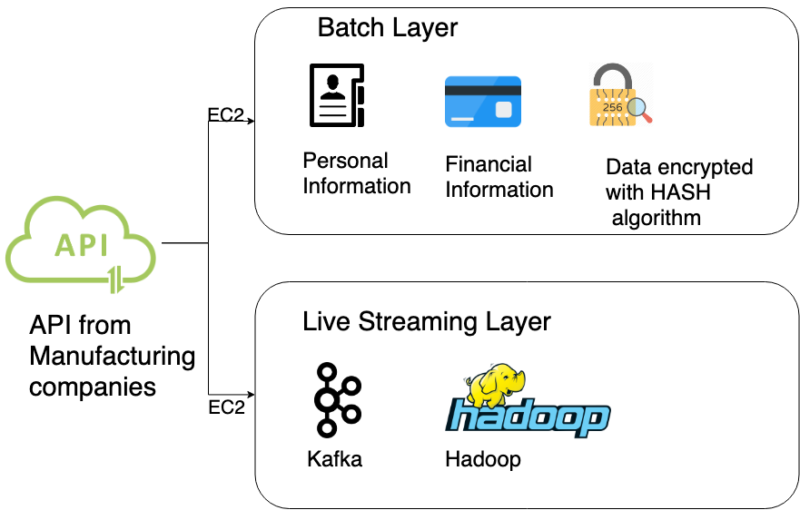
LAMBDA ARCHITECTURE

Slide 40
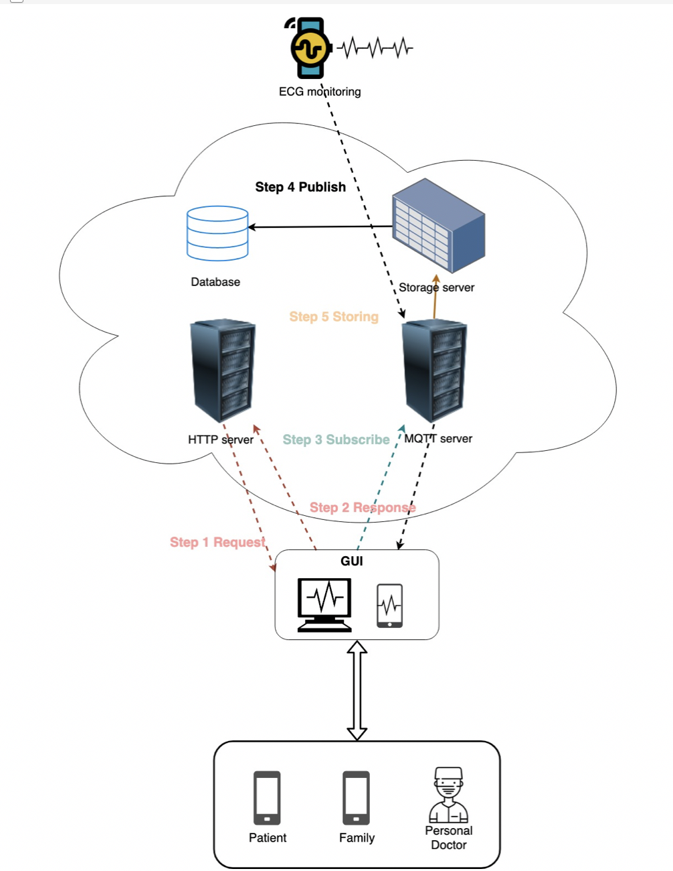

Slide 41
What we learnt and conclusions

Slide 42
What we learnt and conclusions
Real world doesn’t work as we expected!
With the result we got we can move further now
However, we need to be very careful with interpretation
Studies using wearable technology to detect AF are only at their initial stage and have to prove themselves on a bigger scale
Neural networks don’t work well on certain datasets
Having personal data and risk factors for each sample might improve the classification accuracy

Slide 43
Future Work

Slide 44
Development stage
Getting more data
Multiclass classification
Improving results with neural network
Validating results on real-time data
Validating results with cardiologist
Developing stroke detection algorithm

Slide 45
Anomaly detection from ECG of smartwatch

Slide 46
Gracias!

